Slide 1
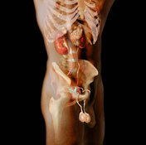
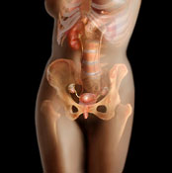
The Body’s Reproductive
System

Slide 2
Learning Outcomes
By the end of this lesson I will be able to:
  Label the male reproductive system
  State the function of each structure in the male system
  Describe two disorders that affect male reproductive systems

Slide 3
The function of the reproductive system
Within the context of producing offspring, the reproductive system has four functions:
To produce egg and sperm cells
To transport and sustain these cells
To nurture the developing offspring
To produce hormones

Slide 4
The male reproductive system
Produces, maintain and transport sperm (the male reproductive cells) and semen (the protective fluid around sperm).

Slide 5
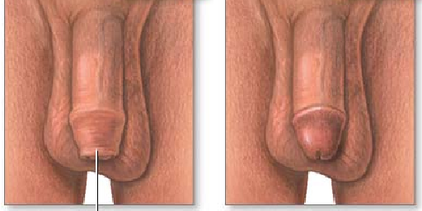
Male Reproductive System
External Structures
Penis: external male sex organ
- Circumcised: removes some or all of foreskin
- Uncircumcised: foreskin not removed
Scrotum: sac of skin and muscle containing testicles
Uncircumcised
Circumcised

Slide 6
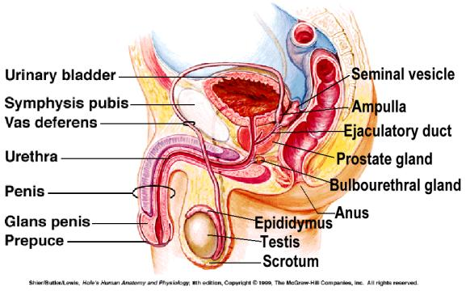
Male Reproductive System

Slide 7
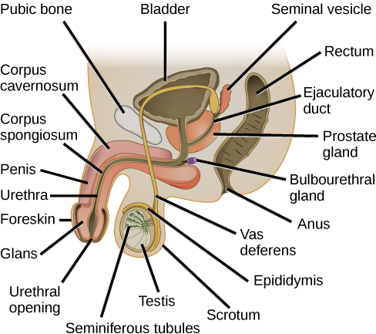

Slide 8
Male Reproductive System
Internal Structures
Prostate: exocrine gland of male reproductive system
Vas Deferens: tubes connecting epididymis to ejaculatory ducts
Epididymis: organ where sperm matures
Testicles: organ where sperm is created
Urethra: tube that connects bladder to outside of body
Cowper’s Gland: secretes lubricating fluid
Seminal Vesicle: make semen (seminal fluid)
http://www.youtube.com/watch?v=HPH4bVKaU4Y

Slide 10
Structure and Function
The Sperm Pathway
Seminal vesicles
Testes
Ejaculatory duct
Sperm
Prostate gland
Epididymis
Urethra
Vas deferens
Expulsion
from the body

Slide 11
Scrotum
A sac-like pouch located behind the penis that holds each testes and helps regulate temperature for sperm production.
Click here

Slide 12
Testicles or Testes
The two testes are small organs that lie in the scrotum and produce sperm and the male hormone testosterone.
The testicles are outside the body because the male sperm that is manufactured in the testes need cooler-than-body temperature for normal growth and development.
Loss of one does not impair the function of the other.
Four to five billion sperm cells are produced each month.
Click here

Slide 13
Testoterone
the male reproductive hormone made by the testicles which causes the changes of puberty.
This hormone causes secondary sex characteristics, production of sperm and sexual urge.
It is produced in the testicles and enters the bloodstream at a fairly constant rate.
Click here

Slide 14
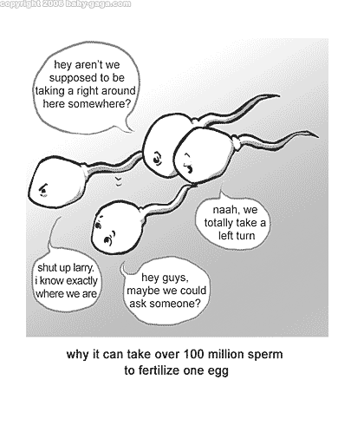
Sperm
The microscopic cells produced by the male's testicles which can fertilize the female's ovum.
They are tiny, living cells 100 times smaller than a pencil dot. (the smallest cell in a mans body
Enough sperm would fit on the head of a pin to re-populate the earth if each sperm fertilized an egg.
It is destroyed by warm body temperature, acidic environment.
It can survive in a women’s body for 5-8 days.
Any sperm not ejaculated are passed in the urine.
Click here

Slide 15
Epididymis
the structure that forms a mass over the back and upper part of each testes.
Sperm are stored there for as long as six weeks while they ripen to maturity.
Click here

Slide 16
Cowpers Gland
two small pea-sized glands located beneath the prostate gland on both sides of the base of the penis.
They secrete a clear, sticky fluid that helps to neutralize the acidity of the urethra.
Click here

Slide 17
Vas Deferens
two long, thin tubes that serve as a passageway for sperm and a place for sperm storage.
The contraction of the vas deferens along with the action of the cilia help transport the sperm through the vas deferens.
Click here

Slide 18
Seminal Vesicles
two small glands that secrete a fluid that nourishes and enables the sperm to move.
Click here

Slide 19
Prostate Gland
surround the urethra beneath the bladder. The gland secretes an alkaline fluid that neutralizes the acid found in the male urethra and the female reproductive tract.
Without the action of the secretions of the prostate gland, many sperm would die and fertilization of an ovum would be impossible.
Click here

Slide 20
Urethra
A dual purpose tube that both semen and urine pass through to leave the body. Semen and urine never mix.
Special muscles or sphincters surround the urethra.
During urination, one sphincter will relax so that the pressure from the bladder will push urine out from the body.
During ejaculation, another sphincter will relax so that semen can flow through the urethra to the outside of the body.
Click here

Slide 21
Penis
The male organ for sexual intercourse, reproduction, and urination.
The reproductive purpose of the penis is to deposit semen in the vagina during sexual intercourse.
The head of the penis or glans contains many nerve endings. At birth the glans is covered by a loosely fitting skin called the foreskin.
When the penis is erect it is 5-7 inches long An erection occurs when the sponge-like chambers in the penis fill with blood.
Click here

Slide 22
SEMEN:
a combination of fluid that is produced in the seminal vesicles, prostate gland, and Cowper's gland. This fluid nourishes and helps sperm move through the urethra.
Click here

Slide 23
EJACULATION
the passage of sperm from the penis, a result of a series of muscular contractions.
Click here

Slide 24
TIME LINE:
Infancy
  Erections begin
Ages 11-14
  Secondary sex characteristics appear
Ages 13-16
  Sperm produced in adult amounts (puberty)
Late teens
  Peak sexual urges for boys
Throughout life
  If good health is present, there is the sex urge and ability to father children

Slide 25
Male Reproductive Disorders

Slide 26
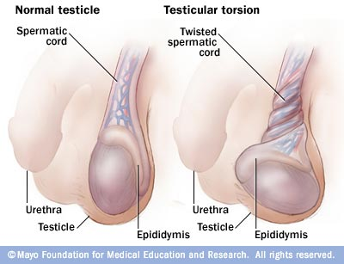
Testicular Torsion
Testicular torsion is the twisting of the spermatic cord, which cuts off the blood supply to the testicle and surrounding structures within the scrotum.

Slide 27
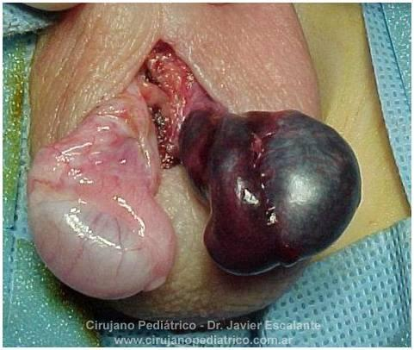
Testicular Torsion

Slide 28
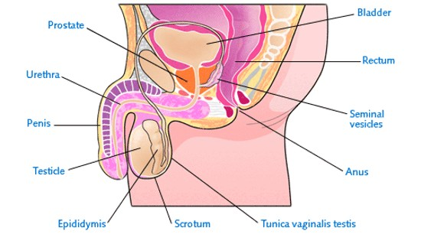
Prostate Cancer
Cancer of the Prostate
Most Common in African American men over the age of 50

Slide 29

Testicular Cancer
most common cancer in males between the ages of 15 and 34
highly treatable when diagnosed early
Testicular Cancer
Signs include…
collection of fluid in the scrotum
lump or enlargement in either testicle
Unexplained fatigue

Slide 30
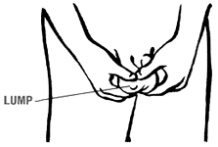
Performing Testicular Self-Exams
Step 1: Draw a warm bath to relax the scrotum
Step 2: Get familiar with your body
Step 3: Place one leg on an elevated surface
Step 4: Use one hand to support testicle
Step 5: Use the other hand to gently roll testicle between thumb and index finger
Look for: Hard lumps, tenderness,
hardness of testicle or discharge of
the penis

Slide 31
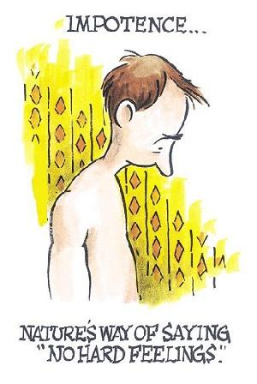
Impotence
Impotence is a common problem among men
characterized by the consistent inability to sustain an erection or the inability to achieve ejaculation, or both.

Slide 32
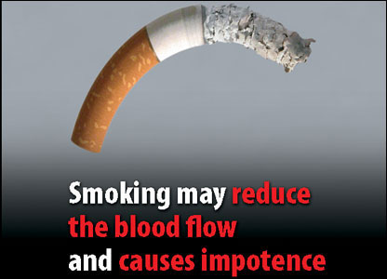
Cause of Impotence

Slide 33
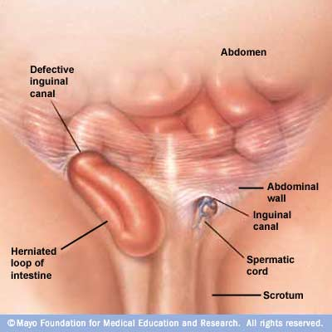
Inguinal Hernia
Inguinal hernias occur when part of the intestine protrudes through a weak spot in the abdomen — often along the inguinal canal, which carries the spermatic cord in men

Slide 34
YouTube
https://www.youtube.com/watch?v=-XQcnO4iX_U

Slide 35
Female Reproductive system

Slide 36
Learning Outcomes
By the end of this lesson I will be able to:
  Label the female reproductive system
  State the function of each structure in the female system
  Describe two disorders that affect female reproductive systems

Slide 37
The female reproductive system
The female reproductive parts function together produce eggs and hormones, maintaining a pregnancy, and facilitating childbirth.

Slide 38
Female Reproductive System
External Structures
Mons Pubis: soft mound of flesh above genitals
Labia: lip-like structures on the outside of the vagina
Clitoris: sex organ whose sole function is pleasure

Slide 39
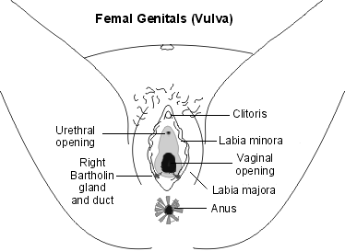
External Organs

Slide 40
Female Reproductive System
Internal Structures
Vagina: tract from uterus to exterior
Hymen: mucous membrane around vaginal opening
Cervix: lower, narrow portion of uterus
Uterus: pear-shaped organ containing growing fetus
Fallopian Tubes: pathway for egg travel during ovulation
Ovaries: egg-producing organs

Slide 41
Ovary (Ovaries)
Two solid egg-shaped structures
They are attached to the uterus by ligaments. They are the counterpart of the male testicles.
Ovaries have two main functions:
#1-store and release the ova or female egg cell. Some of the ova disappear; others are dormant until each is ripened and released after puberty.
  #2-produce female sex hormones ESTROGEN and PROGESTERONE
Click here

Slide 42
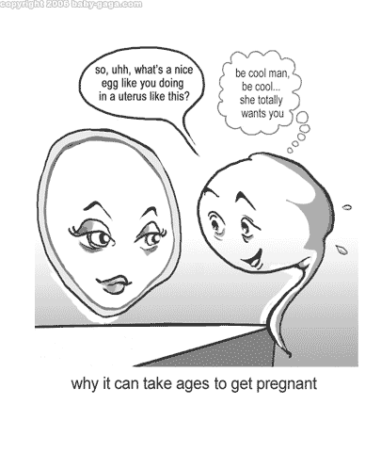
Ova
The female reproductive cell.
They are the largest cells in the female body. (about the size of a grain of sand.)
The female baby is born with all the ova she will ever have (about 200,000 in each ovary).
About 400-500 ova mature and are released over a lifetime
Click here

Slide 43
Estrogen
Estrogen is responsible for the secondary sex characteristics and the sex drive in females. It spurs the onset of puberty and is responsible for OVULATION.
Click here

Slide 44
Progesterone
Progesterone builds up the lining of the uterus called the endometrium in preparation for the fertilized ovum
Click here

Slide 45
Ovulation
When the egg is released from the ovary.
At the age of puberty
The ovum moves to the surface of the ovary in bursts out
The ova falls into the fallopian tube and waits for fertilization
This happens every 28 days
It happens at about the 14th day of the cycle
Click here

Slide 46
FALLOPIAN TUBES
(oviducts)
Two tubes attached on either side of the uterus.
They are about four inches long and 3/16 inch in diameter (the size of a cooked spaghetti noodle).
The oviducts carry egg cells toward the uterus and sperm cells toward the egg cell.
Fertilization takes place in the upper third of the oviduct.
Click here

Slide 47
Uterus
A hollow, muscular organ (shaped somewhat like an upside-down pear, about the size of a fist).
The uterus is lined with endometrium (a blood lining.)
The uterus has one main function—to protect and nourish a fetus
The walls of the uterus have the ability to stretch to the size of a small watermelon.
After childbirth the uterus shrinks back to the original shape in 6-8 weeks, but it can take up to nine months for the uterus to fully recover.
Click here

Slide 48
Cervix
The neck or opening of the uterus.
A normal healthy cervix is the strongest muscle in the body.
It dips down about half an inch into the vagina.
It is normally plugged by mucus. It stays tightly closed during pregnancy, but thins and opens for the delivery of the baby.
How big does it need to dilate to for birth?
Click here

Slide 49
Vagina
Female organ used for intercourse, it is an empty passageway leading from the vaginal opening to the uterus.
It is only 3-4 inches long, but will lengthen during arousal.
The vaginal walls are made of many small folds of membrane that stretch greatly to accommodate a baby during birth.
The vaginal wall also secrete a fluid that helps to make intercourse easier.
Click here

Slide 50
Urethra
The opening to the bladder
Click here

Slide 51
Clitoris
A small, pea shaped bump at the front of the labia.
It contains a small amount of erectile tissue.
The clitoris increases sexual pleasure
Click here

Slide 52
Woman’s Cycle
Day 1 – Menstruation begins (bleeding)
Day 5 – Menstruation is usually ended
Day 14 – Ovum has matured and bursts out of
the ovary
Day 15 – After 24 hours the egg is done
Day 26 – In the absence of fertilization,
estrogen/progesterone levels drop
and the endometrium lining breads
down
Day 28 – Menstruation begins again.
Click here

Slide 53
TIME LINE:
Ages 9-12
  Secondary sex characteristics appear
Ages 11-14
  Menstrual cycle begins
Late 20-30's
  Peak sexual urges
Ages 45-55
  Menopause (cycle stops, but sex urge continues)
Click here

Slide 54
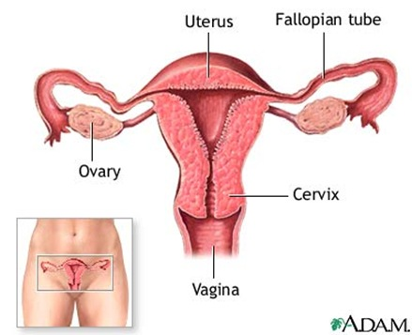
Internal Female Reproductive Organs

Slide 55
Female Reproductive Systems Disorders

Slide 56
Pelvic Inflammatory Disease
Progressive infection—gets worse over time
Affects fallopian tubes, uterus, cervix or ovaries
Can lead to long term reproductive problems
Symptoms include: foul-smelling discharge, heavier than normal periods, painful urination
Causes: bacteria move upward from a woman's vagina or cervix (opening to the uterus) into her reproductive organs. Many different organisms can cause PID, but many cases are associated with gonorrhea and chlamydia, two very common bacterial STDs

Slide 57
Toxic Shock Syndrome
Systemic illness: it affects the whole body
Caused by toxic bacterial
Ways to get it…
Using superabsorbent tampons
Wearing a diaphragm or contraceptive sponge
Having a staph or strep infection, especially if you have skin wounds or healing surgical incisions
Symptoms include: high fever, rapid drop in blood pressure, sun burn like rash, weakness, headaches and even kidney failure

Slide 58
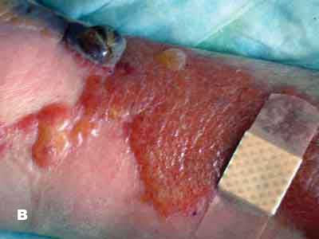

Slide 59
Endometriosis
In Endometriosis, the tissue begins to grow on the outside of the uterus
Causes: menstrual blood containing endometrial cells flows back through the fallopian tubes and into the pelvic cavity instead of out of the body. These displaced endometrial cells stick to the pelvic walls and surfaces of pelvic organs, where they grow
Symptoms include: severe pelvic pain, constipation, diarrhea
Pain when having intercourse, can cause infertility

Slide 60
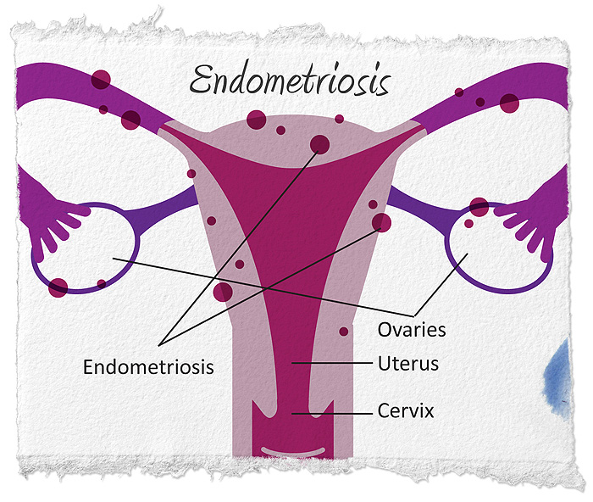

Slide 61


The Facts About Breast Cancer
Second Leading cause of cancer among women (232,340 new cases a year)
Every 3 minutes a woman is diagnosed with breast cancer. 1 in 8 women will be diagnosed in their lifetime.
Approximately 2,150 men will be diagnosed each year.
There are 2.8 million breast cancer survivors today.
Early detection is the best way to protect yourself

Slide 62


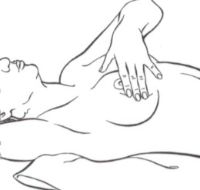
Performing A Breast Self Exam
First, look for changes…Then, feel for changes
Step 1: Lie down and raise right arm above head
Step 2: Examine area from underarm to lower bra line; across to breast bone; up to collar bone; back to armpit
Step 3: Use pads of three middle fingers of the left hand to check the right breast, in dime-sized circles

Slide 63
Female Reproductive System
https://www.youtube.com/watch?v=RFDatCchpus

Slide 64
Male Reproductive System
https://www.youtube.com/watch?v=-XQcnO4iX_U&t=401s

